Slide 1

J. B. INSTITUTE OF ENGINEERING AND TECHNOLOGY (UGC Autonomous) (Accredited by NAAC, Approved by AICTE & Affiliated to JNTU, Hyderabad) Yenkapally, Moinabad Mandal, R.R. Dist., Hyderabad-500075 2020-2021
ADVANCED FOOTSTEP POWER GENERATION SYSTEM USING RFID FOR CHARGING
Under the Guidance of | Submitted by
-Mr. P Ravikiran Assistant Professor | V.Pranitha 18671A0447 G.Vamshi 18671A0453 Md.sohel 18671A0464

Slide 2
Objective
Day by day, the population of the country is increasing and the requirement of the power is also increasing.
At the same time the wastage of energy is also increasing in many ways.
So, reforming this energy back to usable form is the major solution.
So, in this footstep power generation project, we are generating power with the help of human’s footsteps either by walking or running.

Slide 3
Major components:
Battery
Micro controller
Piezo sensors
Charging circuit
LCD
RFID module
LED

Slide 4
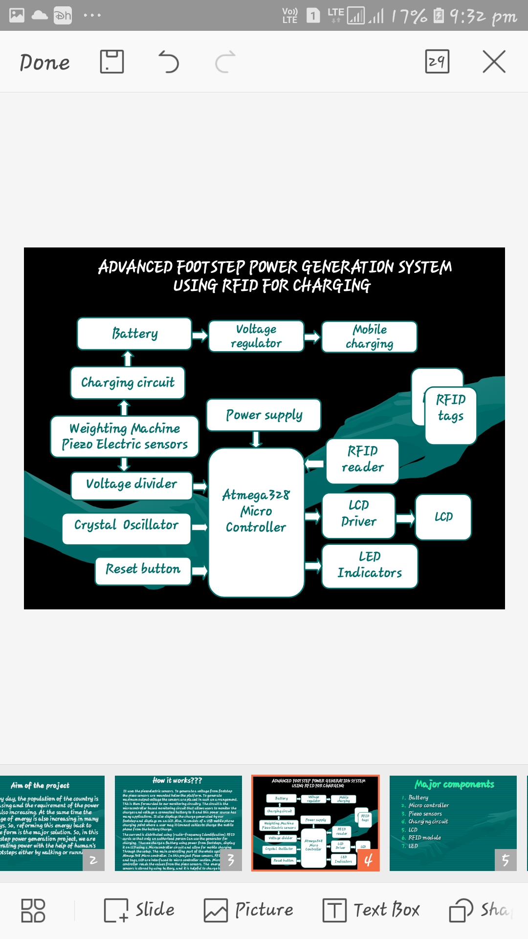
Block diagram

Slide 5
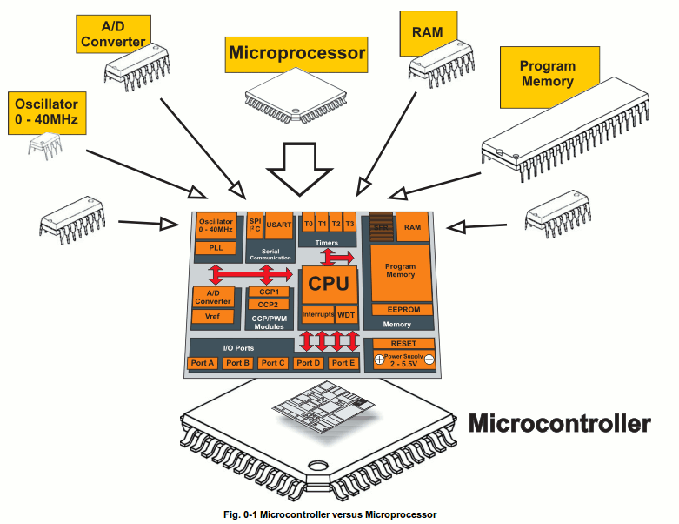
What is a Microcontroller
A small computer on a single chip
containing a processor, memory, and input/output
Typically "embedded" inside some device that they control
A microcontroller is often small and low cost

Slide 6
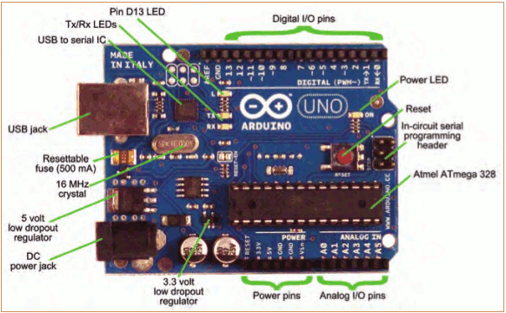
The Arduino Development Board

Slide 7
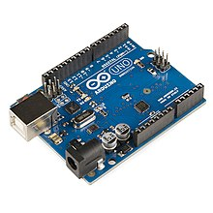
ARDUINO IDE
The Arduino integrated development environment (IDE) is a cross-platform application (for Windows, mac OS, Linux) that is written in the programming language Java. It is used to write and upload programs to Arduino compatible boards, but also, with the help of 3rd party cores, other vendor development boards.
The source code for the IDE is released under the GNU General Public License, version 2. The Arduino IDE supports the languages C and C++ using special rules of code structuring

Slide 8
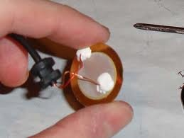
Piezo electric Sensor:
A piezoelectric sensor is a device that uses the piezoelectric effect, to measure changes in pressure, acceleration, temperature, strain, or force by converting them to an electrical charge.

Slide 9
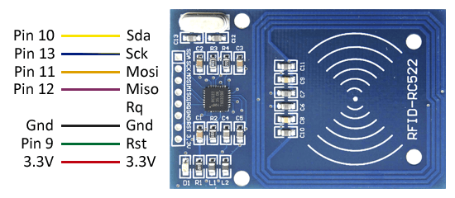
RFID READER
A Radio Frequency identification Reader(RFID reader) is a device used to gather information from an RFID tags, which is used to track individual objects. Radio Waves are used to transfer data from the tag to a reader
It detects the card and sends 12 digit alphanumeric unique code on the serial port

Slide 10
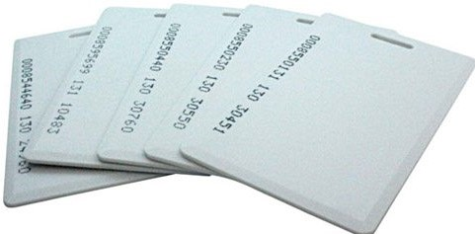
RFID Tags
A Radio Frequency Identification Tags (RFID tag) is an electronic tag that exchanges data with in a RFID reader through radio waves.
Most RFID tags are made up of at least two main parts. The first is an Antenna, which receives RF waves. The second is an IC, used for processing and storing data.
RFID tag also know as a RFID chip.

Slide 11
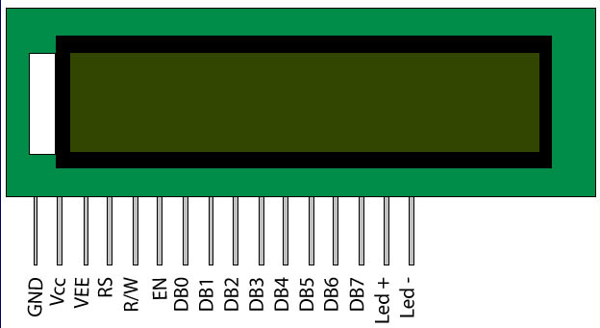
16X2 LCD Display
This Interface an LCD with an Arduino. You can easily interface a liquid crystal display with an Arduino to provide a user interface.
Liquid Crystal Displays (LCDs) are commonly used to display data in devices such as calculators, microwave ovens and many other devices.

Slide 12
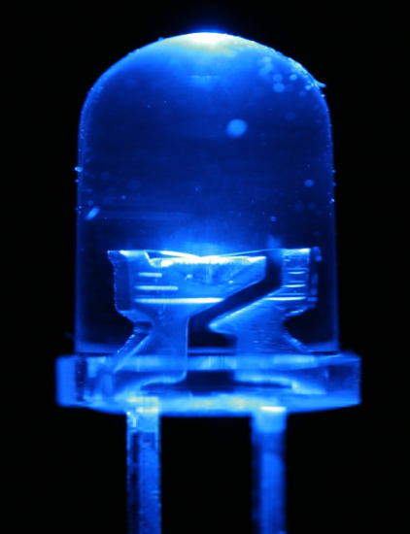
LIGHT EMITTING DIODE:
A light-emitting diode (LED) is a semiconductor
diode that radiates light (electro luminescence) when current passes through it in the forward direction.

Slide 13
Working
It uses the piezoelectric sensors.
To generate a maximum output voltage from footstep the piezo sensors are mounted below the platform.
This is then forwarded to our monitoring circuitry.
The circuit is the microcontroller based monitoring circuit that allows users to monitor the charges and voltage a connected battery to it and this power source has many applications.
It also displays the charge generated by our footstep and displays on an LCD.
Also, it consists of a USB mobile phone charging point where a user may it Connect cables to charge the mobile phone from the battery Charge.
.

Slide 14
•The current is distributed using (radio-frequency Identification) RFID cards so that only an authorized person Can use the generator for charging. •Thus we charge a Battery using power from footsteps, display it on LCD using a Microcontroller circuit and allow for mobile charging Through the setup. •The main controlling part of the whole system is Atmega328 Micro controller. •In this project Piezo sensors, RFID reader and tags, LCD are interfaced to micro controller section. Micro controller reads the values from the piezo sensors. •The energy from the sensors is stored by using battery, and it is helpful to charge the mobile

Slide 15
Advantages:
Helps in renewable energy generation.
Storing of piezo sensor.
Charging of the mobile.
RFID based authorized person detection
Visual display onto the LCD
Efficient and low-cost design.
Low power consumption.
Easy to operate.

Slide 16
Disadvantages:
This system requires periodic monitoring and maintenance.

Slide 17
Applications
This system can be installed at homes ,schools, colleges.
Crowded areas like railway stations, bus stations, airports.
Also at busy footpaths like markets,malls.
Moreover in music halls, auditoriums etc.

Slide 18
References
[1] Manish Bhupathi, ShahramMoradpour, "RFID Field Guide -Developing Radio Frequency Identification Systems", Prentice Hall, 2005, pp 7-9, 16-225, 160,231.
[2] Sewon Oh, Joosang Park, Yongioon Lee, "RFID-based Middleware System for Automatic Identification", IEEE International Conference on Service Operations and Logistics, and Information, 2005.
[3] Shi-Cho Cha Kuan-Ju Huang Hsiang-Meng Chang, " An Efficient and Flexible Way to Protect Privacy in RFID EnvironmentwithLicenses",IEEEInternationalConference RFID, April16-17,2008.
[4] Raj Bridgelall, Senior Member, IEEE, " Introducing a Micro wireless architecture for Business Activity Sensing",
IEEE International Conference RFID, April 16-17,2008

Slide 19
Thank You

